Slide 1
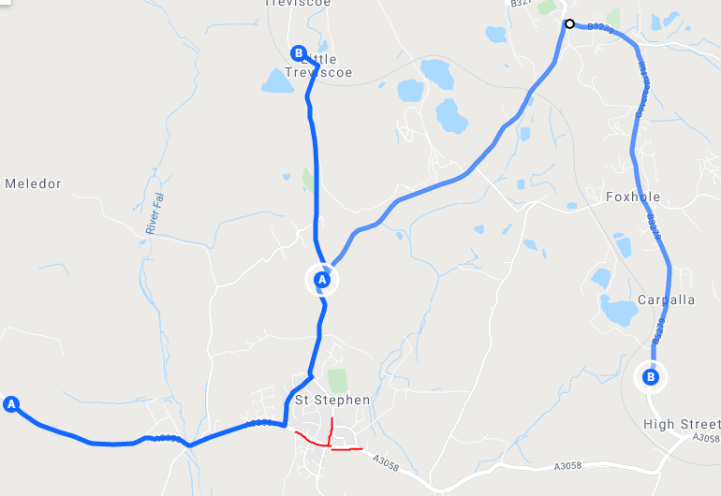

CUSTOMER NOTICE
Roadworks affecting the network
St Stephens Road closure
On Monday 1st November 2021 7:30- 18:00
The road through St Stephens will be closed to all traffic. Bus services from Truro/ Newquay will turn up Creekavose and turn left towards Treviscoe. Service 22 will return to normal route here. Service 29 will operate into St Austell via Nanpean and Foxhole.
Services from St Austell will use the same route in the other direction.
We apologise in advance for any disruption and inconvenience caused by these essential works. For further information please contact Go Cornwall Bus on 0808 196 2632

